Slide 1
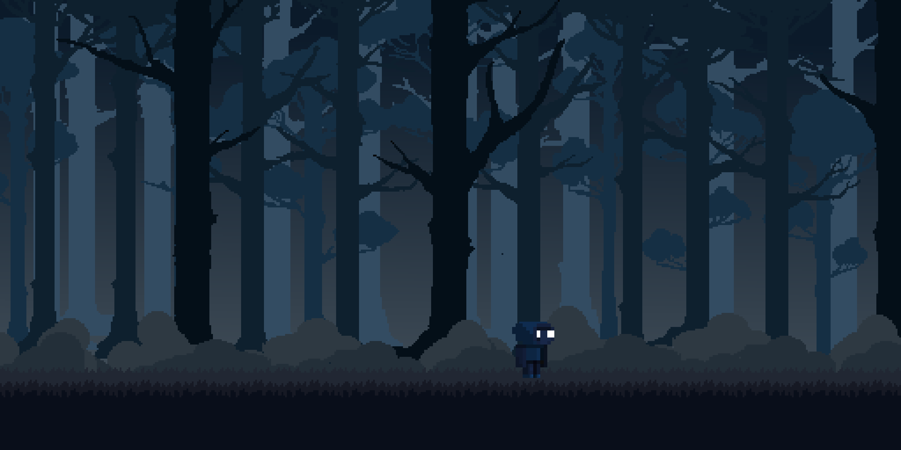

Prove your mastery! The objective is simple: get your cursor from start to finish without grazing the walls. Are your nerves up to the task? There are five intense stages waiting to truly test your hand control.
START

Slide 2

Level 1

Slide 3
Level 2

Slide 4
You Lose
Play again

Slide 5
Level 3

Slide 6
Level 4

Slide 7
Level 5

Slide 8

You won!
Back to Start

